Slide 1
Exploratory Data Analysis

Slide 2
Data Exploration by using Scatter Plots
Before you start the modelling for two continuous variables, you need to decide the pattern for these two variables. This pattern is called as “Functional Form” of relation between two continuous variables.
We need to check whether two variables are linear or not.
Check the relationships between two variables.
We can achieve the above tasks either by using scatter plots or by using correlation statistics between two variables.
We already seen the scatter plot in picturing the distribution.
Correlation measures the degree of linearity between two continuous variables.

Slide 3
Data Exploration by using Scatter Plots
Scatter Plots are useful to accomplish the following:
- explore the relationship between two variables
- locate unusual observations
- identify the possible trend
- identify the basic range of X and Y
- communicate the data analysis
Through Scatter Plot, we can identify the series of possible trend between two continuous variables and based on that trends, we can use or transform the variable in our modelling work.

Slide 4
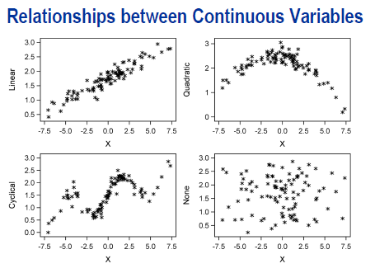
Data Exploration by using Scatter Plots

Slide 5
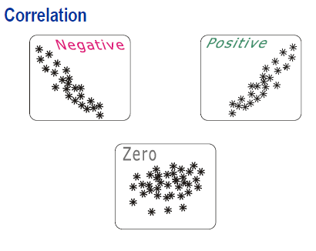
Correlation Analysis

Slide 6
Correlation Analysis
Correlation measures the degree of linear association between two variables. A common correlation statistics used for continuous variables is “Pearson Correlation” Its value are as follow:
- between -1 to 1
- closer to either extreme if there is high degree of linearity
- close to 0 if there is no linear association
- greater than 0 if there is positive linear association
- less than 0 if there is negative linear association

Slide 7
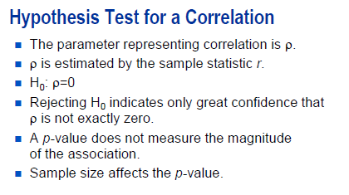
Correlation Analysis
The null hypothesis for a test of correlation
coefficient is p=0. Rejecting the null
hypothesis only means that you can confident
that true population correlation is not 0
Small p-values can occur because of very large
sizes.
Even correlation coefficient of 0.01 can be statistically significant with large sample sizes. Therefore, it is important to look at the value of r itself to see whether it is meaningfully large or not…

Slide 8
Correlation Analysis
Common errors can be made while interpreting the correlation between the two variables.
One of the example is to consider the correlation as “cause and effect relationship”
A strong correlation between two variables does not mean the change in one variable affect the other variable to change.
“Correlation does not imply causation”

Slide 9
DEMO

